Slide 1

Deep Learning Techniques in Load Forecasting
Presented By:- Tolulope Olugbenga

Slide 2
Outline
Introduction / Overview
Investigation
The Benchmark Algorithms
Deep Learning Algorithms
Metrics for Evaluation
Preliminary Analysis – Toronto, Ottawa, Saint John Dataset
Contributions

Slide 3
Introduction / Overview
Load forecasting has been used for over a century to plan and operate electric grids. Reserve power must be stored to ensure a consistent supply of electricity.
Load aggregators, power marketers, independent system operators, regulatory commissions, industrial/commercial firms, banks, trading firms, and insurance companies benefit from load forecasting as well.
It is not easy to develop a forecasting model for a specific power network. Weather, time of day, week, and other variables can all have an impact on load forecasts (i.e., coronavirus outbreak).
Forecasting electricity demand can be made in several ways: very short-term (VSTLF) (1 day), short-term (STLF) (2 weeks), medium-term (MTLF) (3 years), and long-term load forecasting (LTLF > 3 years). Recent research has focused on STLF.
To forecast load, both statistical and machine learning (ML) techniques have been used, and the line between the two is becoming increasingly blurred. ARIMA modeling and multiple linear regression are statistical techniques.

Slide 4
Introduction / Overview
ML algorithms are more intelligent and can adapt to non-linear and complex relationships between load and other influencing factors (such as weather and time of day). Artificial Neural Networks (ANNs) and Support Vector Machines (SVMs) are a few examples.
Recently, researchers in this field are interested in deep learning approaches such as recurrent neural networks (RNN), long-short-term memory networks (LSTM), and 1-D convolution neural networks (CNN) because they can learn about temporal dependencies in data inputs.
Tao Hong discussed the myth of the best technique. He concluded that no single technique is superior.
This is determined by the dataset and the forecasting requirements. No single method is likely to be effective in all load forecasting scenarios. Forecast errors differ greatly across utilities, zones, and time horizons.

Slide 5
Investigation
The accuracy of deep learning forecasters is compared to the accuracy of current and conventional ones being used by utilities. The focus will be on the STLF horizons.
Three different data sets will be examined. To aid reproducibility, data from an Independent Electrical System Operator in Ontario were selected. Both sets cover ten years of hourly city-wide load aggregation measurements from Ottawa and Toronto from 2010 to 2019.
The third dataset from St. John Energy is part of a larger Smart Grid Technologies project at UNB. This dataset corresponds to the hourly city-wide load aggregates for the past 3.5 years (2018 to now).
The weather data were obtained from Environment Canada.
Four benchmark forecasters will be compared: seasonal naive, Multiple Linear Regression (MLR), Auto Regressive Integrated Moving Average (ARIMA), and shallow Artificial Neural Network (ANN). These benchmark algorithms have been used for years by researchers and utilities.

Slide 6
Investigation
The project is divided into three stages. First, we'll construct the benchmark algorithms.
Then a CNN or another deep learning algorithm is used.
Finally, the performance of deep learning forecasters will be compared to the performance of benchmark algorithms using publicly available data sets.
We'll look at both overall and peak detection accuracy. For an overview of completed and pending tasks, please see the Gantt chart in the appendix of my proposal.

Slide 7
The Benchmark Algorithms – Naïve
The naive forecaster is a popular benchmark for developing more sophisticated forecaster. When a naive forecaster outperforms a complex model, we know the complex model is not viable. According to Bracale et al., "the simplest method to predict the next value in a time series is to assume it will have the same values as the current value.“
The Seasonal Naive Forecaster (SNF) improves the naive forecaster by taking seasonal trends into account. The previous season's value is used in this method.
The seasonal naïve forecaster is ideal for predicting variables that are generally stable or vary in a consistent manner. It is ineffective at forecasting time series data that fluctuate or are subject to irregularities such as temperature.

Slide 8
The Benchmark Algorithms - MLR
Multiple Linear Regression (MLR) is a statistical technique commonly used in load forecasting. MLR forecasters use multiple independent variables to model continuous variables.
MLR accuracy is determined by the relationships between the data and the independent variables. Increasing the number of relevant independent variables marginally improves predictive accuracy.
Non-linear relationships can also be simulated by MLRs, but only with direct user input. And MLRs are incapable of learning and adapting to newer factors automatically.
Examples of independent variables are – temperature, hour of the day, day of the week, average demand of the previous day, etc.

Slide 9
The Benchmark Algorithms - ARIMA
A lag feature is any variable that contains data from previous time steps.
Auto-regression, like linear regression, uses past values (lag values) as predictors. ARIMA accomplishes this by combining the Auto regressive (AR) model with a moving average (MA) model. The parameters of the autoregressive and moving average parts are p and q, respectively.
Model parameters include the AR order, p, the MA order, q, and the differencing order, d. Differentiation is required because linear regression models work best when the time series is stationary.
One significant disadvantage of the ARIMA model is the difficulty in determining appropriate parameters for the AR and MA components. These numbers may also vary slightly among datasets and forecast horizons. This can be frustrating and time consuming at times.
Fernandez et al. used ARIMA, polynomial, neural network, and SVM models to forecast energy load for non-residential buildings. The study used data from the University of Deusto in Donostia-San Sebastian, Spain. The goal was to forecast six days ahead of time. Among the other models, the ARIMA model had the lowest MAPE. They noted that the ARIMA model runs 200 times faster than the SVM model due to fewer parameters.

Slide 10
The Benchmark Algorithms – ANNSTLF
The ANNSTLF is a popular ML load forecaster. To forecast short-term load, we will employ the third-generation design, which employs two shallow multi-layer feed-forward ANNs with a recursive least squares (RLS) combiner.
By using error back-propagation, two multi-layer perceptron are trained. The base-load forecaster (BLF) forecasts regular next-day load, whereas the change-load forecaster (CLF) forecasts daily changes in load demand.
The CLF forecaster allows the model to quickly adapt to temperature changes. Both forecasters produce a 24x1 vector representing hourly forecasts. The final CLF's output is calculated by adding predicted changes to last-day values.
In the final forecast, an RLS algorithm computes a weighted average of each block's output.
The ANNSTLF-G3 has improved prediction accuracy and generated economic benefits for a number of utilities. According to some publications ANNSTLF-G3 is the best short-term forecaster.

Slide 11
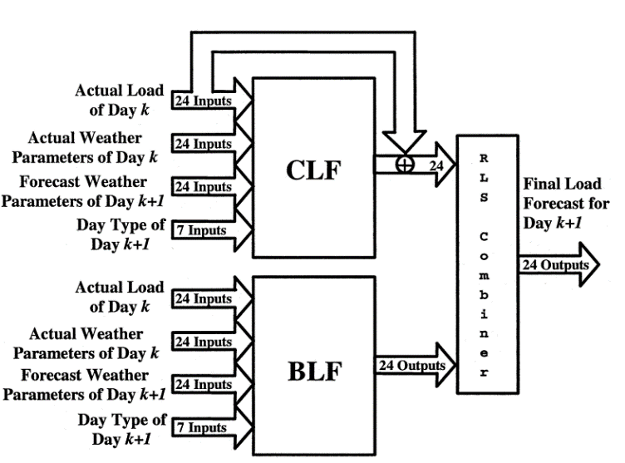
The Benchmark Algorithms – ANNSTLF

Slide 12
Deep Learning Algorithms
The Recurrent Neural Networks (RNN) added memory to neural networks, allowing them to model sequential data. RNNs, however, are susceptible to vanishing or exploding gradients. This flaw resulted in the development of the LSTM algorithm.
The LSTM is a model that can store information for a longer period of time and control gradients more effectively.
Convolutional neural networks (CNNs) have also gained popularity in load forecasting. The CNN is a feed-forward network that uses a grid topology to process data. However, 1D CNNs can be used on time-series data.
CNNs have deeper layers and model parameters such as receptive field length and dilation that can aid in the interpretation of load data.
Amaradinghe et al. compared the CNN to LSTM, SVM, ANN, and other algorithms for individual building load forecasting. They concluded that CNN is a viable method for predicting load.
To build the CNN, we used a Base Load Forecaster, a Change in Load Forecaster, and an RLS combiner to replicate the ANNSTLF structure. The inputs and structure are identical to those of the ANNSTLF, but the BLF and CLF components are trained with CNNs. As time passes, more adjustments will be made.

Slide 13
Metrics for Evaluation
Commonly used performance metrics for load forecasting include Mean Absolute Percent Error (MAPE), Mean Bias Error (MBE), Mean Absolute Error (MAE), Root Mean Squared Error (RMSE), and Standard Deviation (SD).
The MAPE metric is widely used in load forecasting. MAPE returns undefined values when the actuals are zero. Because low forecasts have a maximum percentage error of 100 percent, whereas high forecasts have no such limit, the algorithm penalizes negative errors more severely than positive errors near zero.
MBE assesses the model's overall bias and whether it overestimates or underestimates (MBE > or < 0). Because of the offset effect of positive and negative error pairs, a forecast model can be highly accurate while remaining biased.
MAE is the average magnitude of forecast errors. The MAE error amount is not always visible and distinguishing between major and minor errors can be difficult. To address this, the mean absolute error as a percentage was included (MAPE). The MAE and MAPE may underestimate uncommon but significant errors. By focusing solely on the mean, we risk missing a massive error.

Slide 14
Metrics for Evaluation
The RMSE of the observed and expected values is used to calculate an absolute fit. We included RMSE to account for severe errors. RMSE is an error size measure that favors significant but rare errors above the mean by squaring the errors before computing their mean and then taking the square root of the mean.
Finally, standard deviation compares the spread of errors to the mean. The standard deviation is an excellent indicator of dispersion. Inconsistencies in time series have less of an impact on standard deviation. The standard deviation is heavily influenced by the time series' extreme values. The standard deviation, unlike other dispersion measures, may be more difficult to compute and comprehend.
All of these are simple tools for determining forecast accuracy, but they are not without limitations.
This research will evaluate forecaster performance indicators across forecasts and subsets such as hours of the day, days of the week, and months of the year. It will show us when forecasters outperform or underperform expectations.

Slide 15
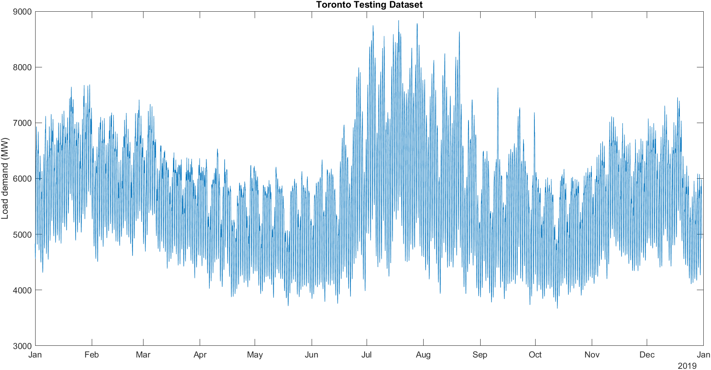
Preliminary Analysis – Toronto Dataset
Metrics | CNN RLS | CNN CLF | CNN BLF | ANN RLS | ANN CLF | ANN BLF | MLR | ARIMA | S-Naïve
'MAPE - Mean Absolute Percent Error' | 2.16 | 2.19 | 2.27 | 2.29 | 2.39 | 2.43 | 3.75 | 4.86 | 6.09
'ME - Mean Error' | -5.41 | -1.23 | -28.90 | -6.71 | 7.99 | -11.31 | -10.81 | 53.98 | -1.67
'MAE - Mean Absolute Error' | 125.73 | 127.10 | 131.84 | 134.64 | 139.40 | 141.26 | 214.88 | 285.43 | 350.36
'MSE - Mean Squared Error' | 36007.64 | 35024.16 | 38191.29 | 40509.58 | 41100.04 | 41441.24 | 86398.61 | 174813.61 | 238215.39
'RMSE - Root Mean Squared Error' | 189.76 | 187.15 | 195.43 | 201.27 | 202.73 | 203.57 | 293.94 | 418.11 | 488.07
'Standard Deviation' | 189.69 | 187.15 | 193.29 | 201.17 | 202.59 | 203.27 | 293.75 | 414.63 | 488.10

Slide 19
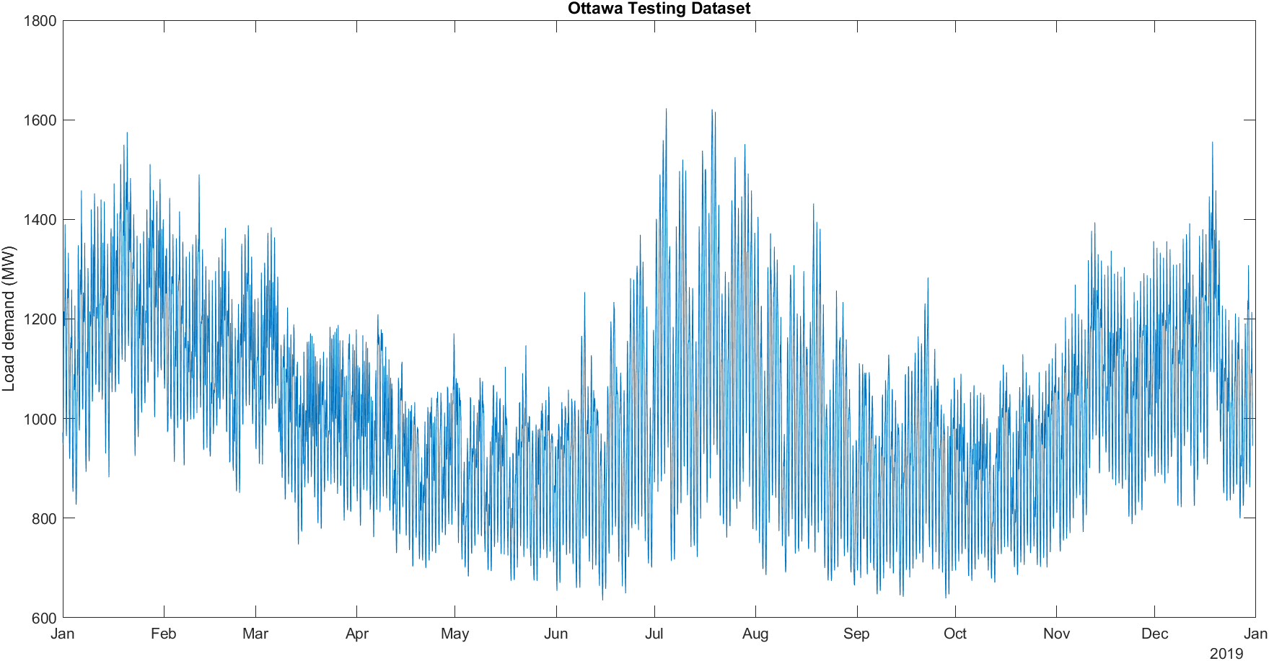
Preliminary Analysis – Ottawa Dataset
Metrics | CNN RLS | CNN CLF | CNN BLF | ANN RLS | ANN BLF | ANN CLF | MLR | ARIMA | S-Naïve
'MAPE - Mean Absolute Percent Error' | 2.72 | 2.85 | 2.96 | 3.11 | 3.47 | 3.56 | 4.78 | 5.06 | 7.33
'ME - Mean Error' | 0.69 | 0.83 | 9.75 | 0.77 | 1.32 | 4.20 | 4.29 | 4.76 | -1.05
'MAE - Mean Absolute Error' | 27.70 | 28.93 | 30.48 | 31.64 | 34.98 | 35.95 | 49.05 | 52.11 | 75.79
'MSE - Mean Squared Error' | 1378.67 | 1440.90 | 1615.39 | 1759.53 | 2033.13 | 2151.74 | 4325.66 | 4991.02 | 10573.67
'RMSE - Root Mean Squared Error' | 37.13 | 37.96 | 40.19 | 41.95 | 45.09 | 46.39 | 65.77 | 70.65 | 102.83
'Standard Deviation' | 37.13 | 37.95 | 38.99 | 41.94 | 45.07 | 46.20 | 65.63 | 70.49 | 102.83

Slide 23
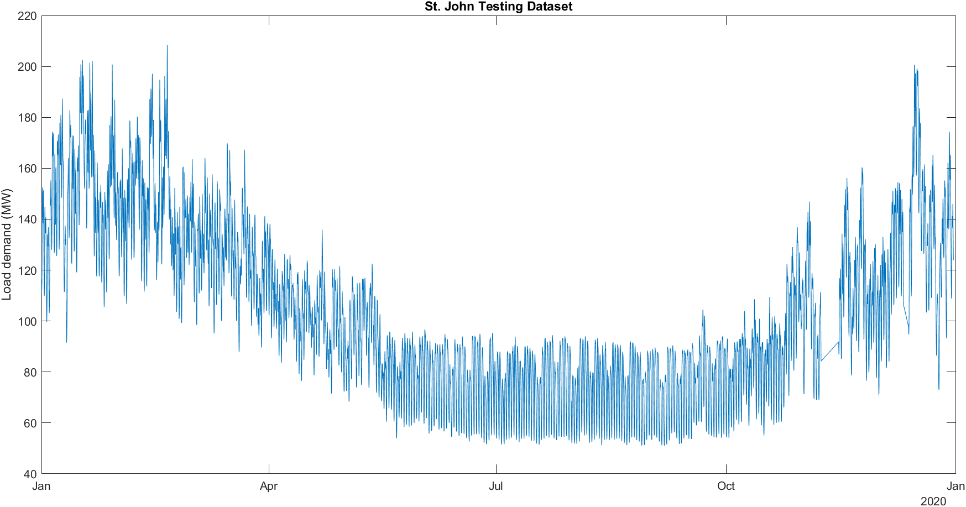
Preliminary Analysis – St. John Dataset
Metrics | ANN RLS | CNN RLS | ANN CLF | CNN CLF | CNN BLF | MLR | ANN BLF | ARIMA | S-Naïve
'MAPE - Mean Absolute Percent Error' | 3.793 | 3.939 | 4.379 | 4.594 | 4.736 | 5.046 | 5.312 | 6.073 | 10.245
'ME - Mean Error' | -0.015 | 0.057 | -0.701 | -0.404 | -0.746 | -0.936 | -1.395 | 0.311 | -0.295
'MAE - Mean Absolute Error' | 3.843 | 3.800 | 4.371 | 4.270 | 4.437 | 5.277 | 5.004 | 6.497 | 11.383
'MSE - Mean Squared Error' | 29.646 | 28.797 | 34.910 | 33.940 | 37.784 | 54.126 | 46.664 | 89.042 | 293.585
'RMSE - Root Mean Squared Error' | 5.445 | 5.366 | 5.908 | 5.826 | 6.147 | 7.357 | 6.831 | 9.436 | 17.134
'Standard Deviation' | 5.445 | 5.366 | 5.867 | 5.812 | 6.102 | 7.298 | 6.688 | 9.432 | 17.133

Slide 27
Contributions
Researchers will be able to compare the value added by deep learning algorithms (such as CNN and LTSM) to more conventional algorithms as a result of this research.
We want to develop an algorithm (or set of algorithms) that can easily adapt to annual increases in power demand, temperature shifts, and other random variables.
We also want to create algorithms capable of comprehending and interpreting complex data relationships without the need for explicit user input.
This project will also serve as a model for future researchers. Two of our datasets are provided by an independent system operator, and the benchmark algorithms we will employ are well-documented.

Slide 28
Thank you for your attention ☺

